Slide 1
2021 ENDEAVOR TRAINING
KEYS TO SUCCESS WEBSITE:
https://www.ktsutah.org/

Slide 2
KEYS TO SUCCESS CONTACT INFO
Emma Checketts
Keys to Success Program Manager of Higher Education
C: 801-906-3754
emmac@sieutah.org
Mallory Santa Cruz
Keys to Success Program Director
C: 208-403-7165
mallorys@sieutah.org
Notes:
My name is Emma Checketts, I am the Keys to Success Program Manager of Higher Education. I graduated from the U of U about a year ago and started at Keys to Success 6 months ago. This is our wonderful Program Director, Mallory Santa Cruz.

Slide 3
SOCIAL MEDIA
STAY
CONNECTED
Instagram: @KTSUTAH
Facebook: @KTSUTAH
Twitter: @KTSUTAH
YouTube: Keys to Success Utah
Website: www.KTSUTAH.org/ENDEAVOR
Notes:
Before I get started, here are our handles and website for the Keys to Success program.

Slide 4
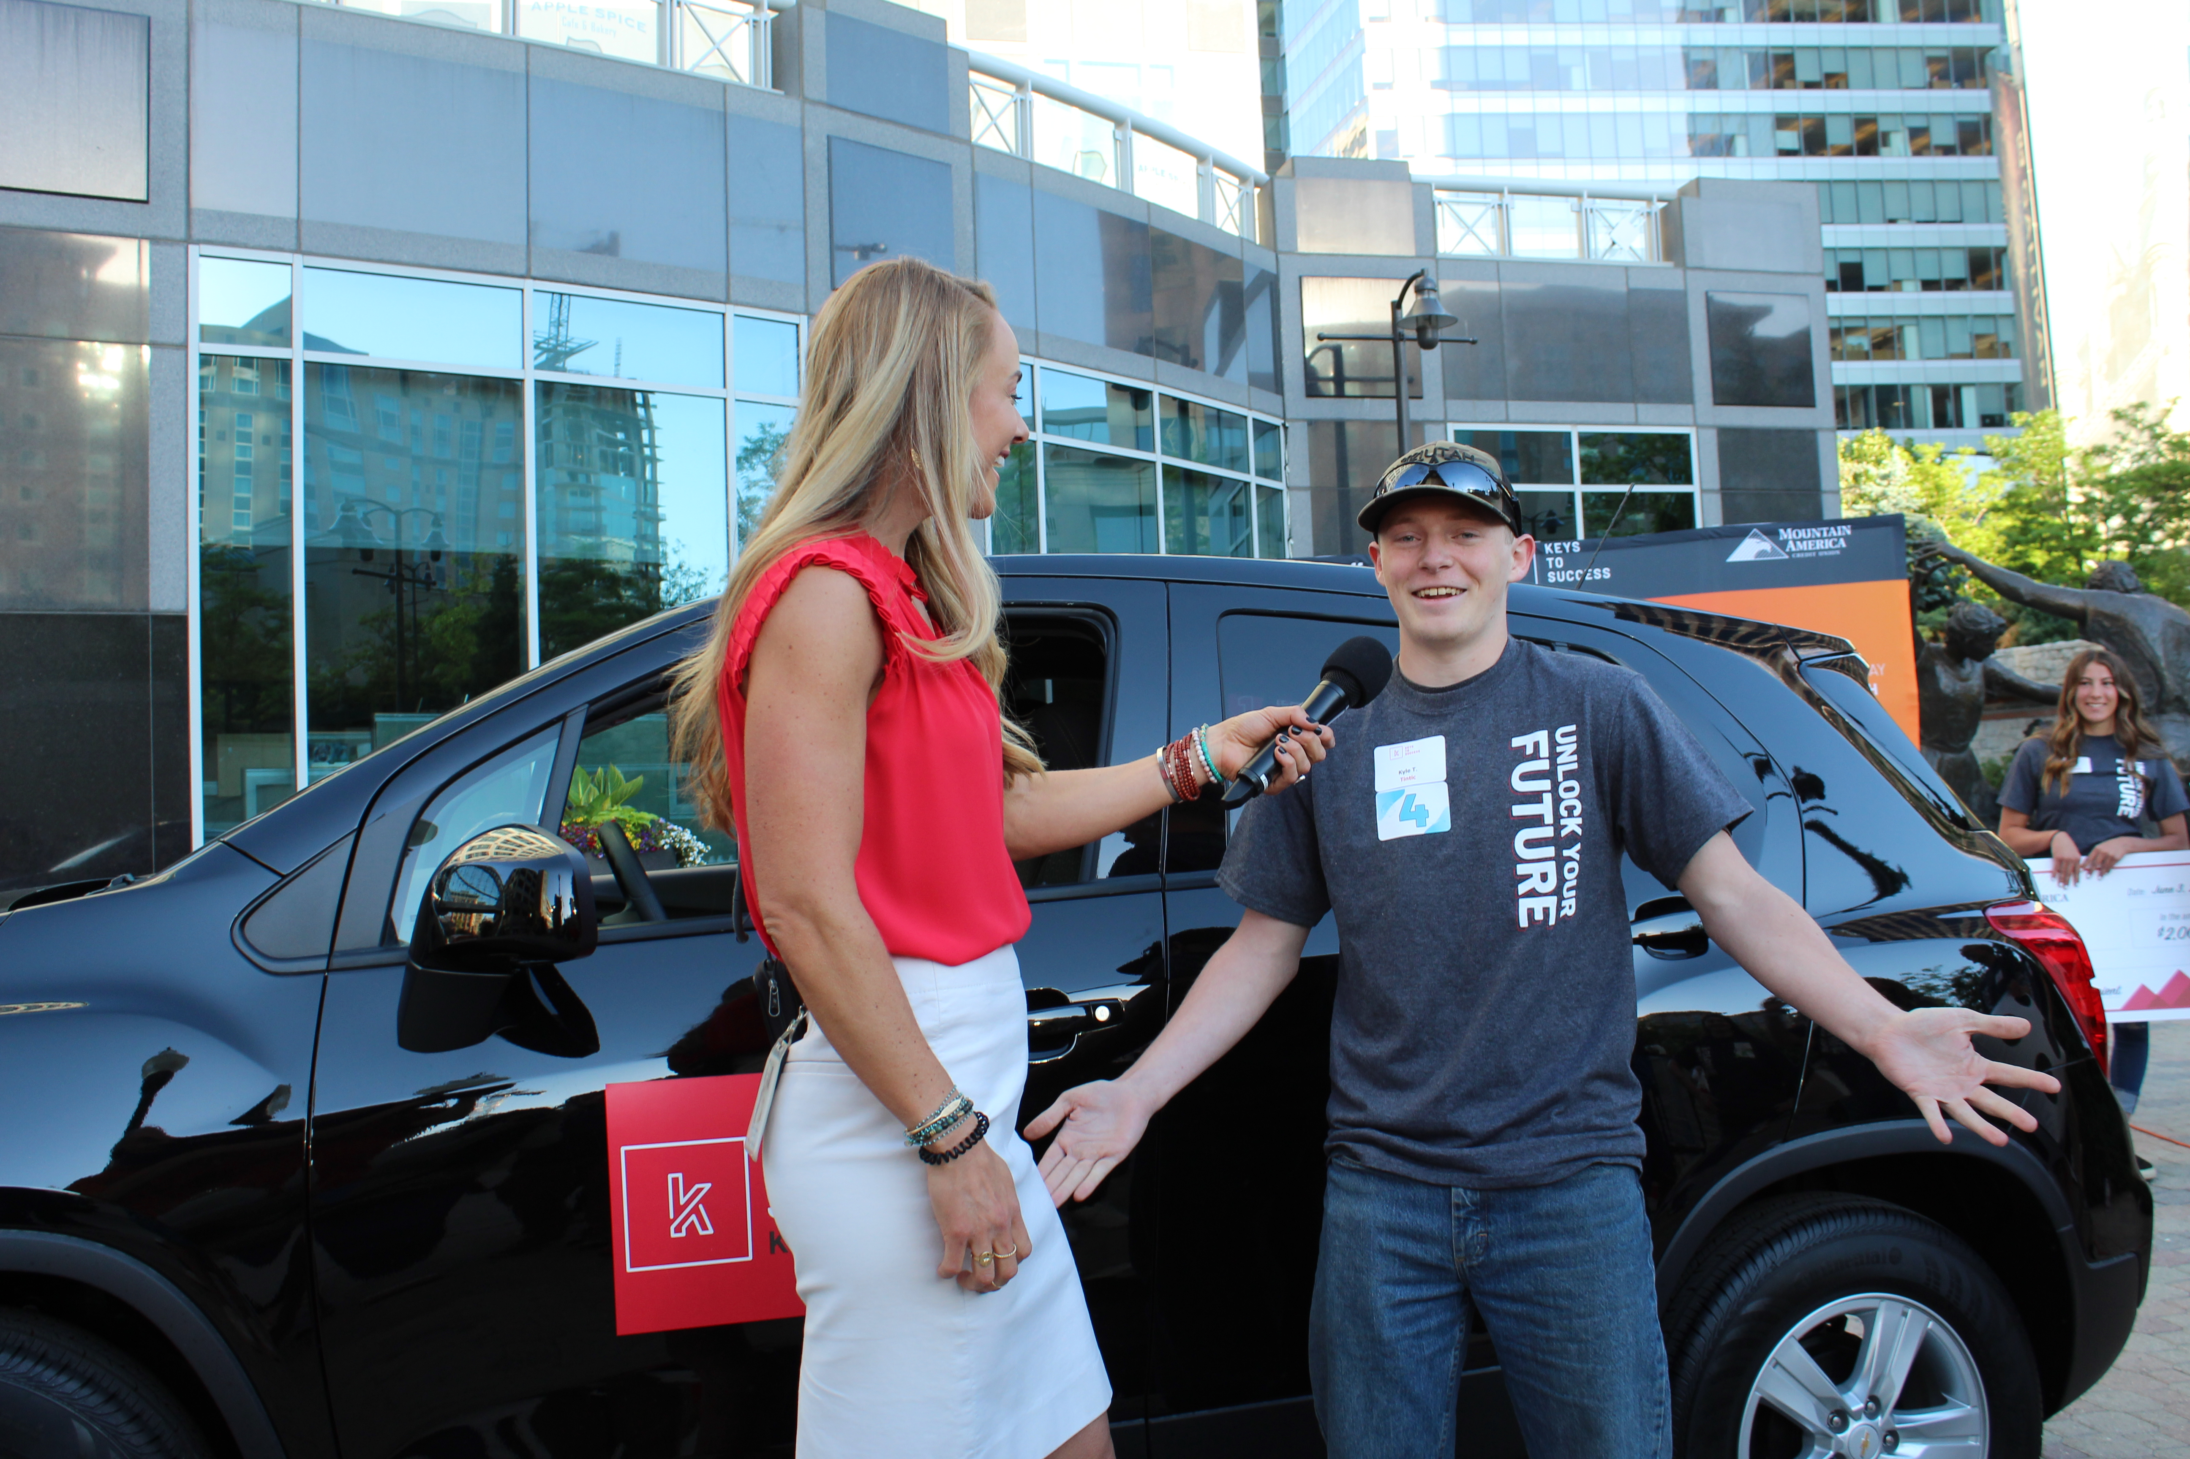
KEYS TO SUCCESS 6th-12th
STUDENT FEATURES:
CTE Pathways Dashboard
Scholarship Database
Internship/Opportunities Database
Personalized Notifications
Ability to Favorite Opportunities
Prize Dashboard Financial Aid Resources
Monthly Parent Emails
STUDENT FEATURES
Notes:
How many of you have heard of Keys to Success?
I'm guessing that most of you either went to high school in Utah or have children who have. Keys to Success started with incentivizing high school students to do well in school. Now we give away a brand new car and have grown to over 70,000 student app users, expanding into middle schools and junior highs.

Slide 5
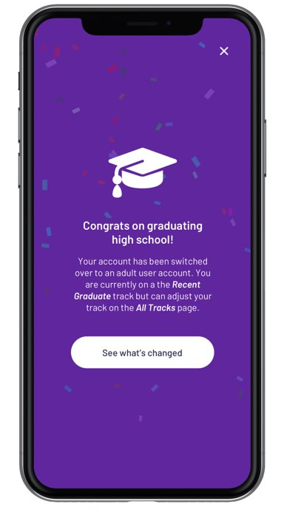
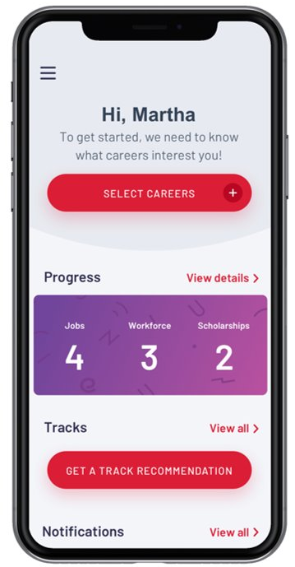
KEEP GOING!
After high school graduation, students can still utilize Keys to Success through the Adult Portal!
Student accounts are automatically rolled over to an adult account upon graduation.
You can access a job board, internships, scholarships, assessments, and more!
ADULT PORTAL
Notes:
As Keys to Success has grown over the last 17 years we had more and more students asking for continued access to Keys even after high school graduation. This year we were able to launch Endeavor, a portal for all Utah adults looking to continue their educational and career goals. I want to go over this resource with you today as a resource for your audiences.

Slide 6
KTS BY NUMBERS
38,000+
TOTAL NUMBER OF APP USERS
17,600+ opportunity engagements
42,500+ scholarship engagements
TOP 5 CAREER INTERESTS
1. Health Science
2. Arts & Communication
3. STEM
4. Human Services
5. Business Management
OUR IMPACT
$160M
SCHOLARSHIP/TUITION WAIVERS AVAILABLE
Notes:
Without marketing this program, we already have 38,000 users and thousands of engagements on the app. Most of these users right now are recent high school graduates. I've also included the top 5 career interests of our users and that we offer $160 million in scholarship and tuition waivers on the app.

Slide 7
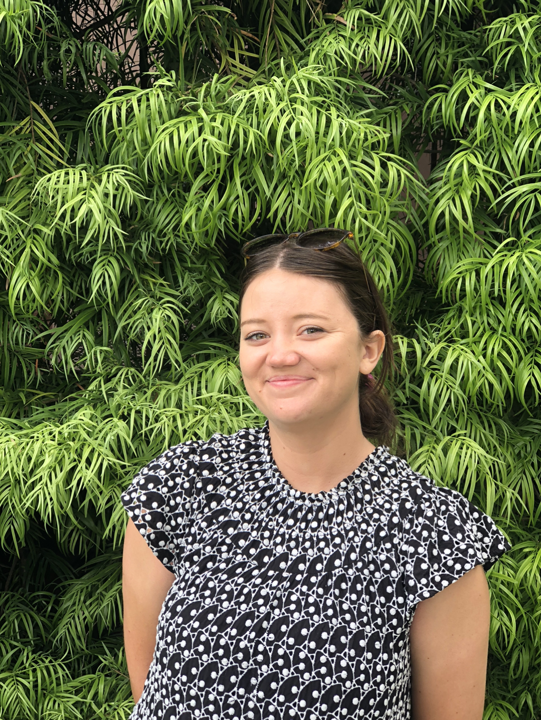
CASE STUDY: JENNY
This is Jenny.
Notes:
To walk you through Endeavor I'd like to introduce you to my friend Jenny. She is 24 years old, from Utah and is at a stage in life that many 20-somethings are right now.

Slide 8
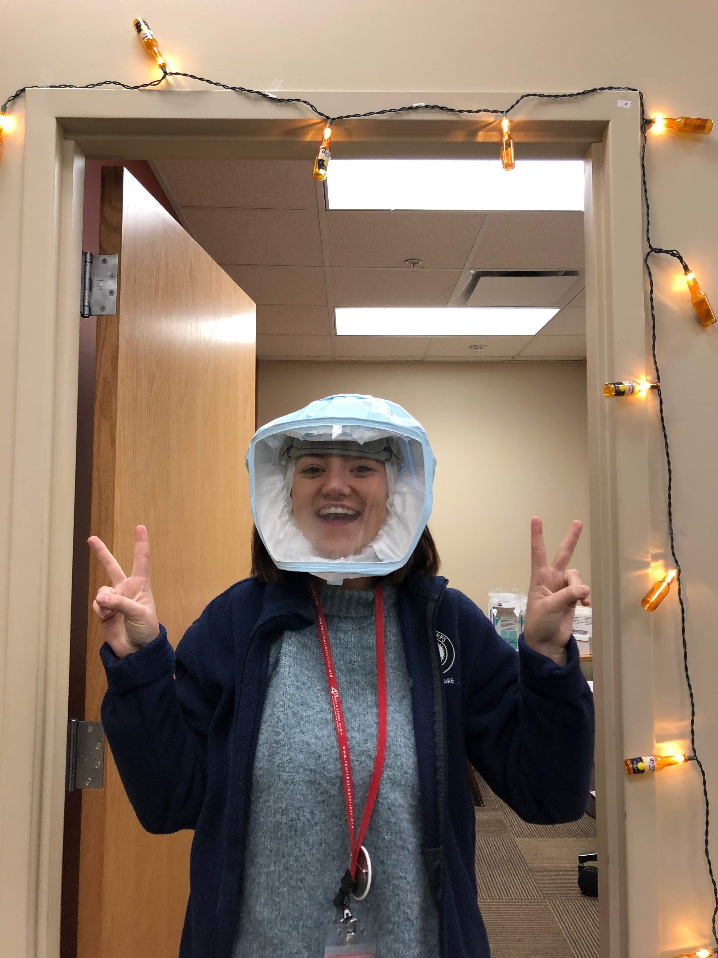
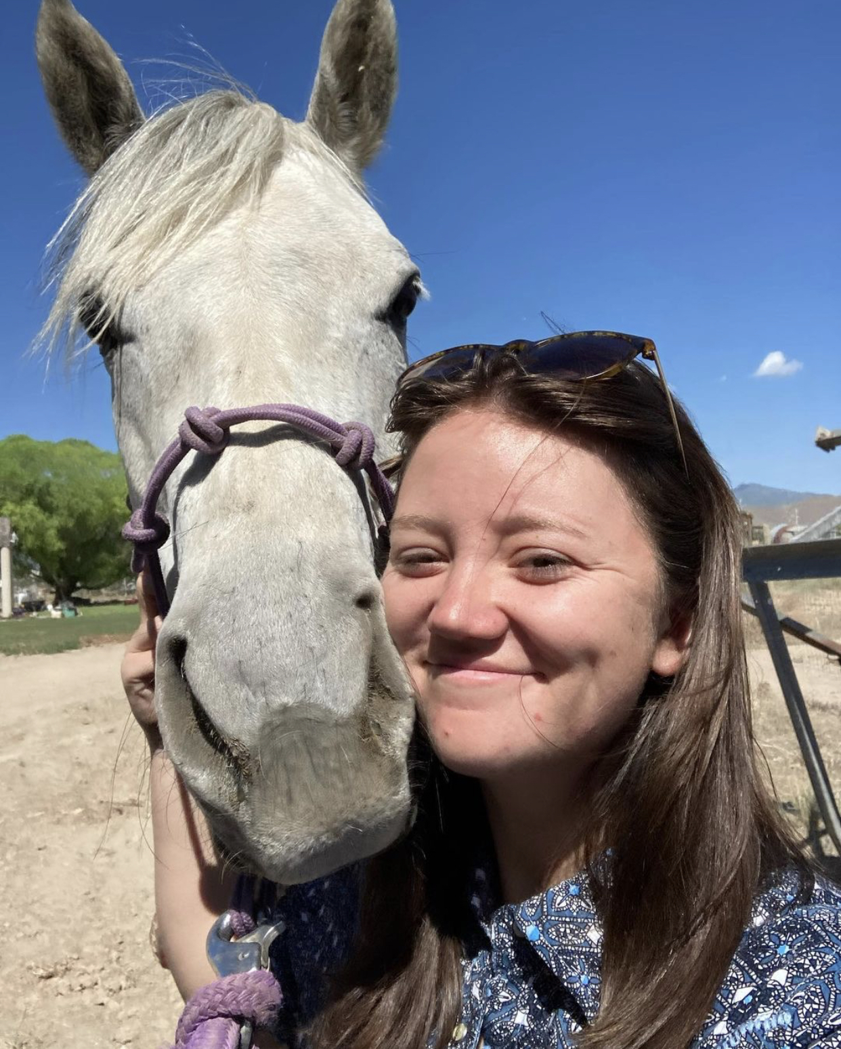
DREAMS
Jenny got her bachelor's degree in public health and worked at a clinic while getting her degree. She's now working on a ranch in Washington with horses, sheep and dogs.
Notes:
Jenny graduated from the UofU with her bachelor's degree in public health. She worked at multiple health clinics while getting her degree. While getting her degree her childhood dream of being a cowgirl called to her, she's now working on a ranch in Washington hearding sheep and training horses. She wants to one day be able to work with horses in an equine therapy situation. She also is eager to get her masters degree in public health, specifically in maternal and child health. Since Jenny has many different passions and interests having a tool to make plans and solidify interests will simplify her life!

Slide 9
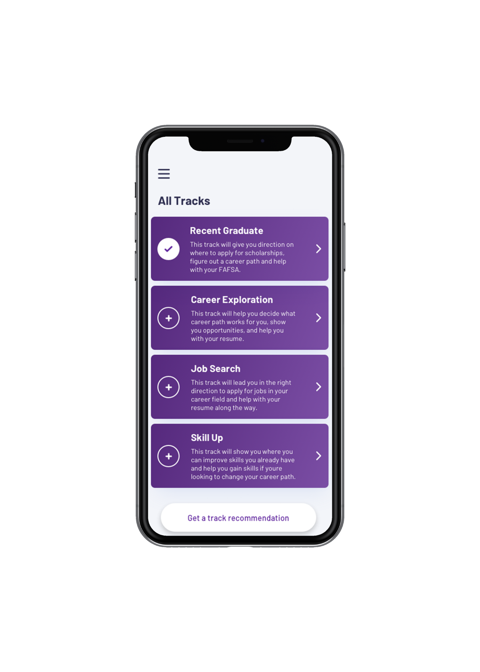
UNIQUE TRACKS
JENNY can pick the "Career Exploration"
track to give her a personalized experience.
Post-secondary Ready
Job Search
Career Exploration
SkillUp
FEATURES
Notes:
While Jenny is working at the ranch she can create an adult account on Endeavor and choose a track that makes the best sense for her. Since she's not quite ready for a Master's degree and she's working a track that would make the most sense for her would be Career Exploration. This will allow the app to give her specific resources and notifications about opportunities pertient to career exploration. We know Utahns from all different background will be utlizing this so we wanted to make sure everyone could find and access what makes sense for them where ever their at. What track would you have chosen when you were 24?

Slide 10
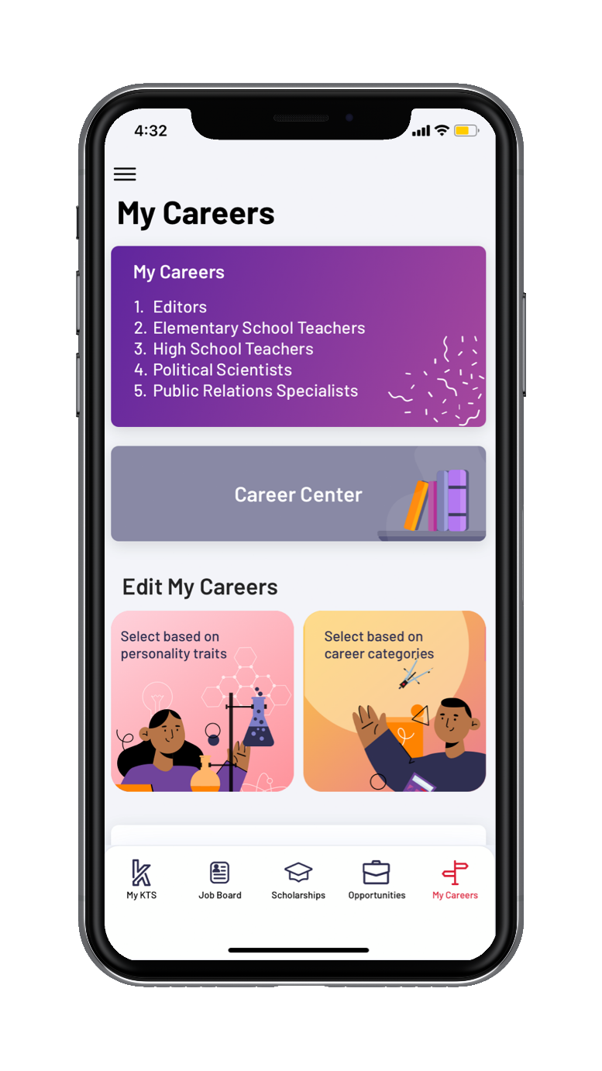
CAREER INTERESTS
What Career Field would JENNY choose?
Agriculture, Food and Natural Resources
Architecture and Construction
Arts, Audio/Video Technology and Communications
Business, Management and Administration
Education and Training
Finance
Government and Public Administration
Health Science
Hospitality and Tourism
Human Services
Information Technology
Law, Public Safety, Corrections and Security
Manufacturing
Marketing, Sales and Service
Science, Technology, Engineering and Mathematics
Transportation, Distribution and Logistics
FEATURES
Notes:
Users are also able to choose career fields that they are interested in to get notificaitons about opportunities that would interest them. Which career fields would Jenny choose?

Slide 11
CAREER INTERESTS
Which Career Field would JENNY choose?
Health Science
Agriculture, Food and Natural Resources
Education and Training
Human Services
STEM
Career Field Assessments
Career Cluster Inventory
Workplace Employability Skills
Entreprenurial Assessment
Interest Profiler
Learning Styles Survey
Occupation Sort
Reality Check
Work Importance Locator
FEATURES
Notes:
I agree! These are the fields I chose for Jenny. I chose Health Science since that's what she got her degree in and is considering getting her masters in something similar. I put Agriculture, Food and Natural Resources opportunities that tie into her animal and ranching experience. Some of the others I chose were some of her lesser interests that maybe she was able to identify in the career field assessments that are housed on the app. I've put a list here, if you want to have a interesting and fun experience I would suggest taking the Reality Check assessment to find out if you're living within your means, it's very eye opening.

Slide 12
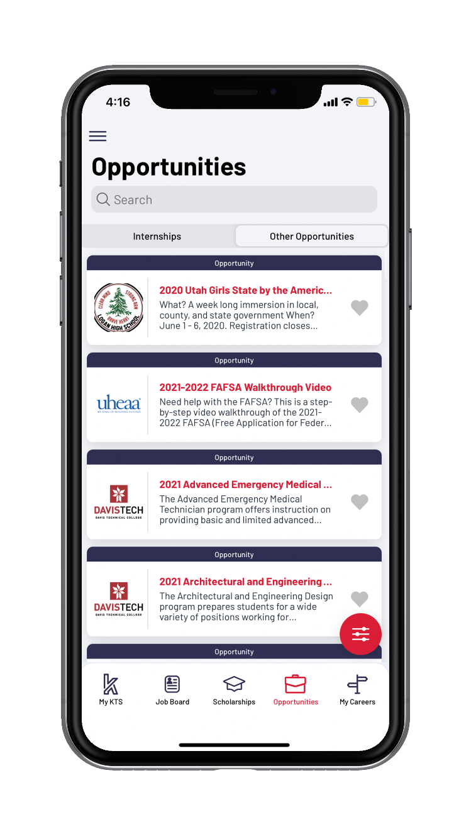
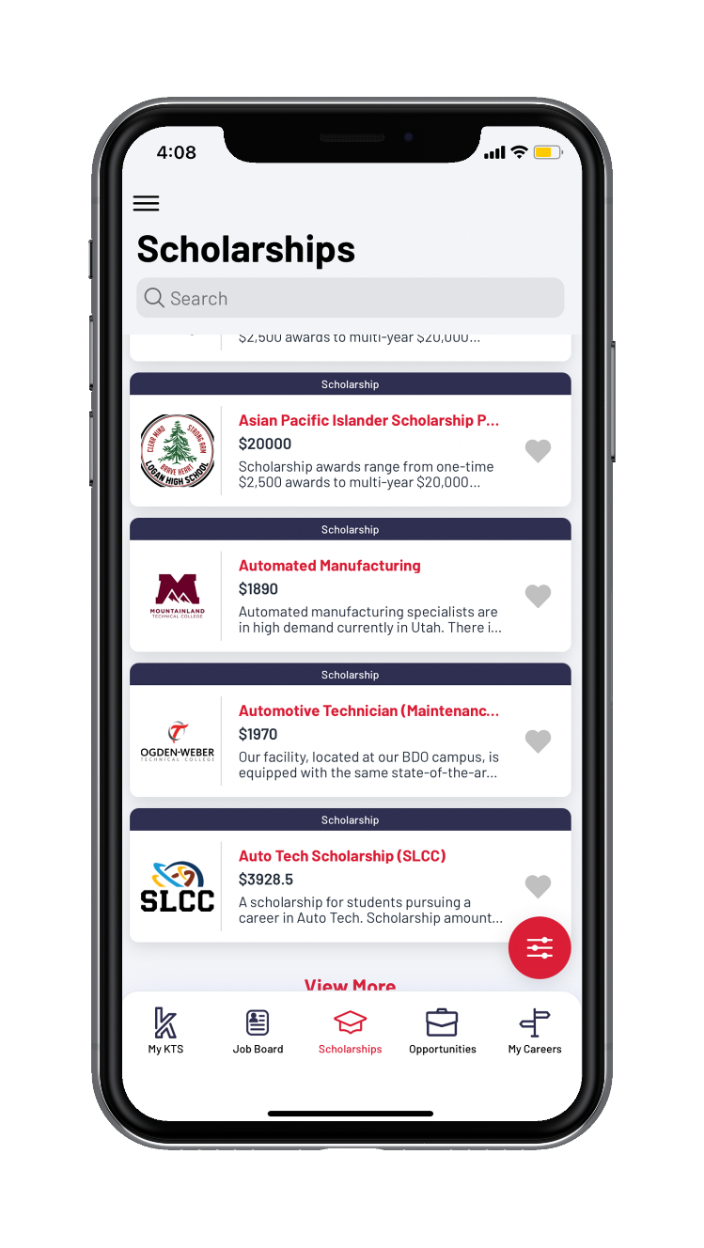
OPPORUNITIES & SCHOLARSHIPS
JENNY wants a Master's degree,
but just spent all her money living in WA herding sheep.
Thanks to our community partners and institutions, she can do that.
FEATURES
Notes:
Another resource within the app is are databases for Opportunities and Scholarships. Opportunities are things like internships, career fairs, campus tours and FAFSA help. These are uploaded by our community organizations who want to introduce our users to their industry or institution. Jenny wants to be able to get her masters degree but has spent all her money living in Washington and herding sheep. With the Keys to Success app she will be able to easily filter and find scholarships in Utah to allow her to realistically do that.

Slide 13
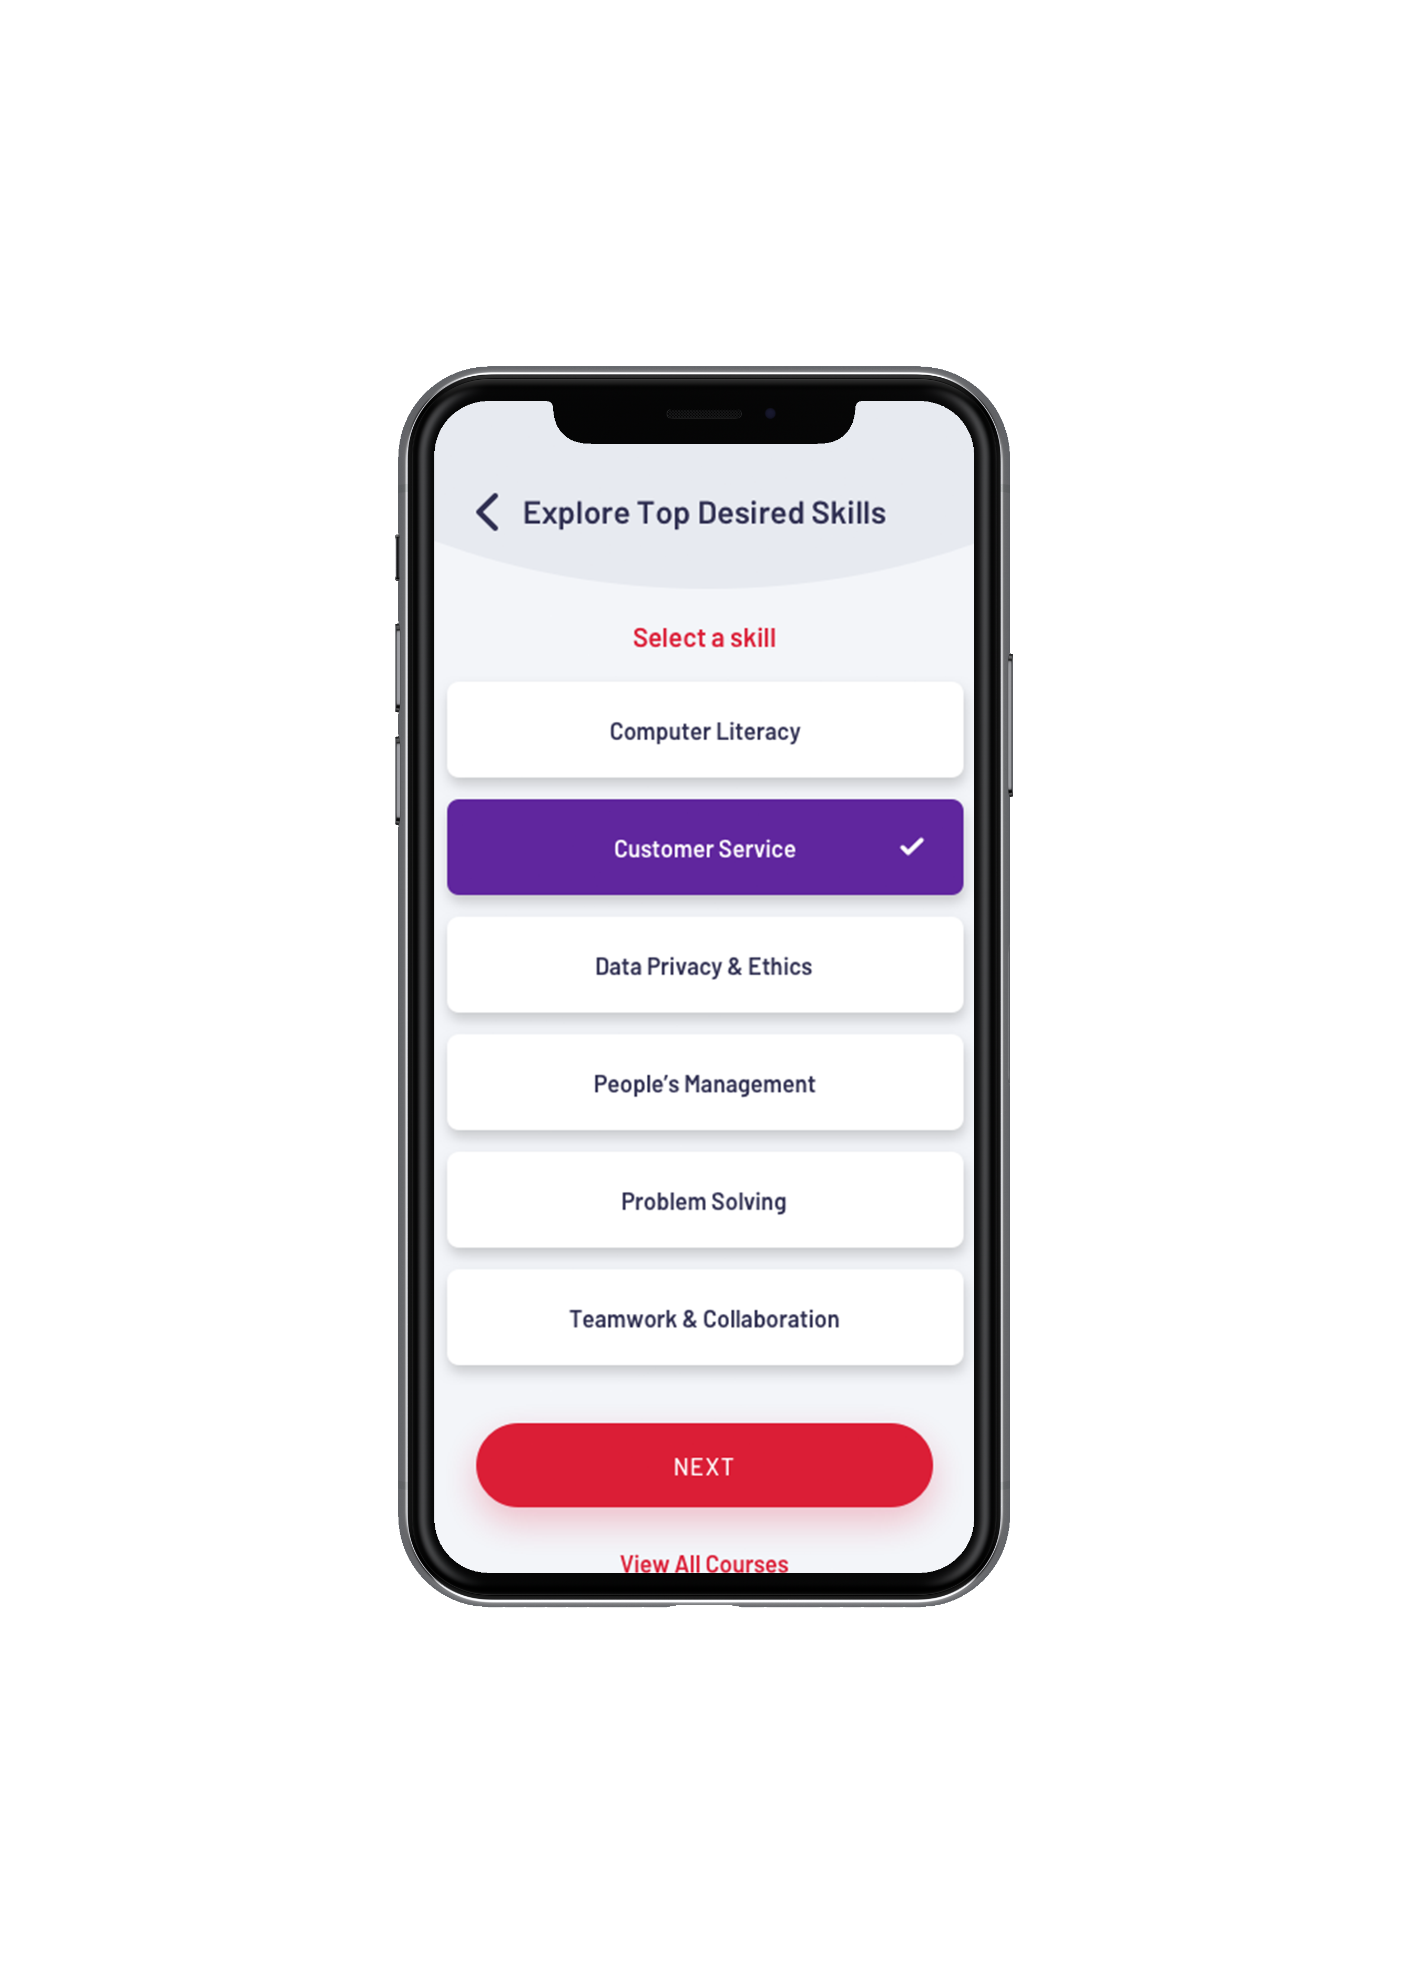
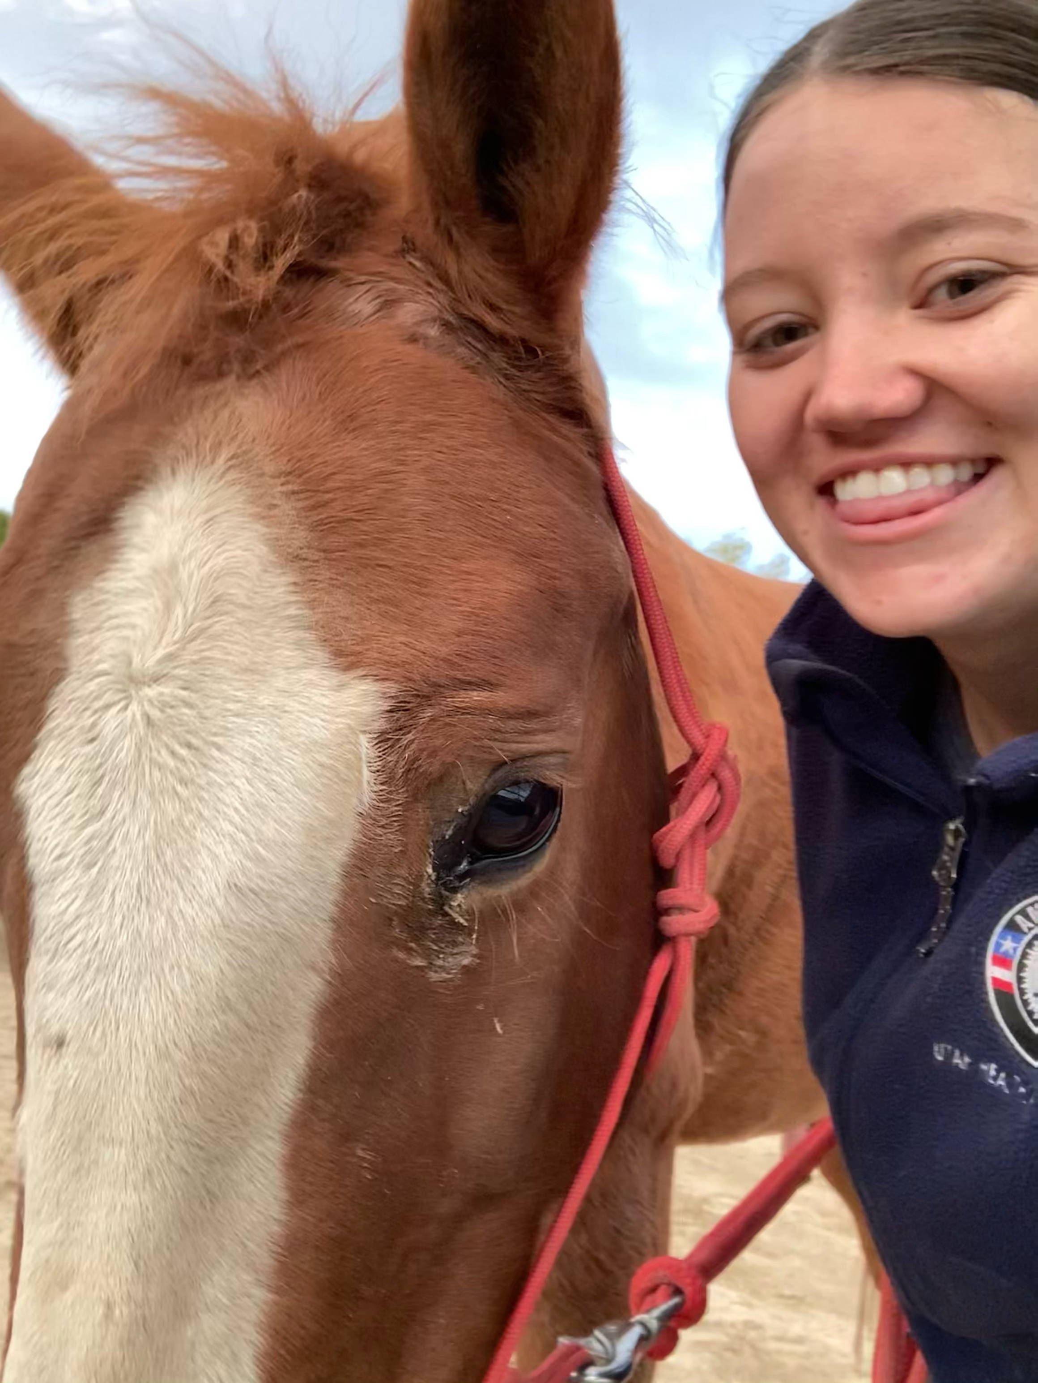
SKILL TRAININGS
JENNY wants to keep learning about equine therapy and animals.
Choose your desired skill and explore free and reduced cost skills trainings from local and national organizations!
FEATURES
Notes:
Since Jenny has a couple hobbies and would like to get a certificate or training in equine therapy. She can find skill trainings in a variety of industries and skills. We are hosting all Learn & Work skill trainings created by GOEO in the app as well. These trainings are either free or reduced cost and don't require enrollment in an instutition. Jenny could be doing one of these while working on her degree.

Slide 14
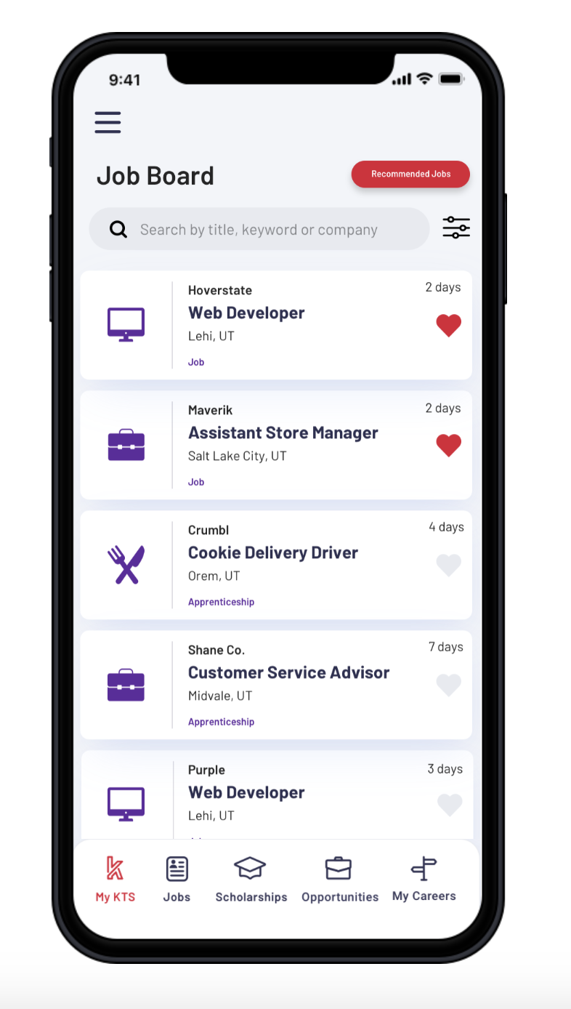
THE PRIZE
During and after her degree JENNY wants a job.
The Job Board is located under “Jobs” and is updated daily by DWS. You can filter and search for jobs that you are most interested in. You can also get job recommendations based on your career interests.
FEATURES
Notes:
Most, if not all, adults are looking for a job. In our app DWS jobs are uploaded daily with filtering available. Jenny can find jobs to apply for here during and after her degree. This is the real prize.

Slide 15
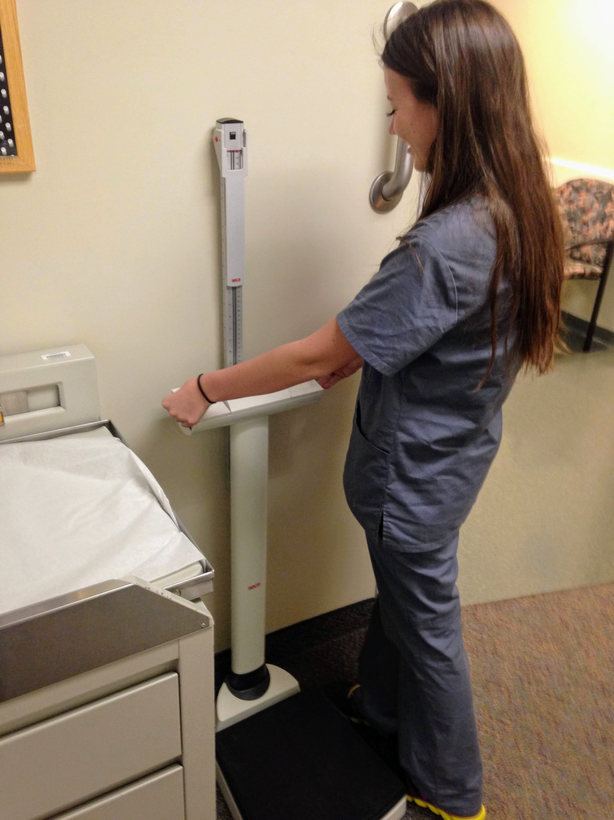
KEEP GOING!
After JENNY graduates which track could she change to?
Post-secondary Ready
Job Search
Career Exploration
SkillUp
FEATURES
Notes:
This is a life-long tool. Whenever you switch focuses or goals you can change your track in Keys to Success to reflect that. After Jenny graduates from getting her Master's degree what track do you think she could change to?

Slide 16
KEEP GOING!
After JENNY graduates which track could she change to?
Post-secondary Ready
Job Search
Career Exploration
SkillUp
FEATURES
Notes:
I chose Job Search for Jenny as she's coming out of graduate school and will be wanting to launch her career.

Slide 17
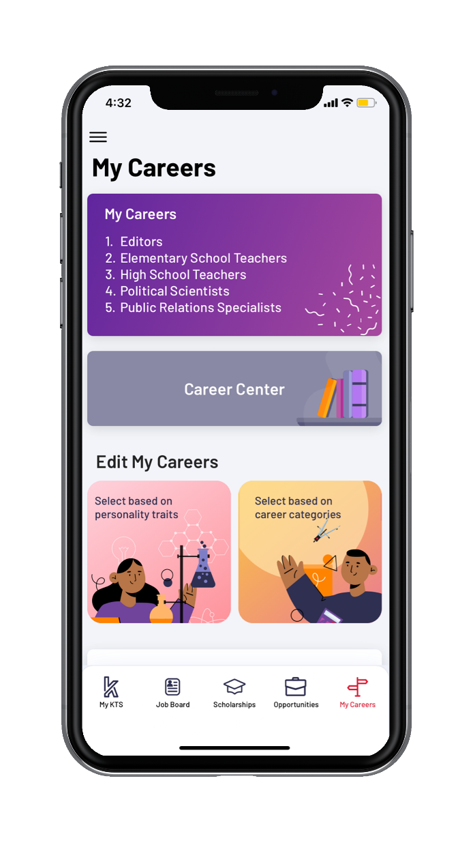
HAVE YOU DOWNLOADED THE KEYS TO SUCCESS APP?
User Features
CareerExplorer by Sokanu
Scholarship Database
Workforce Database (Internships/Opportunities)
Skill Trainings
DWS Job Board
Career Center
Tools & Resources
Personalized Notifications
Users can favorite opportunities
to visit later
* Full desktop version available
Notes:
Now it's your turn! If you haven't already downloaded the Keys to Success app while I've been talking now is a good time. Create an adult account and start browsing what career and educational plans you can make. This is a resource created for the adults you'll be working with. We want to simplify your and their lives.

Slide 18
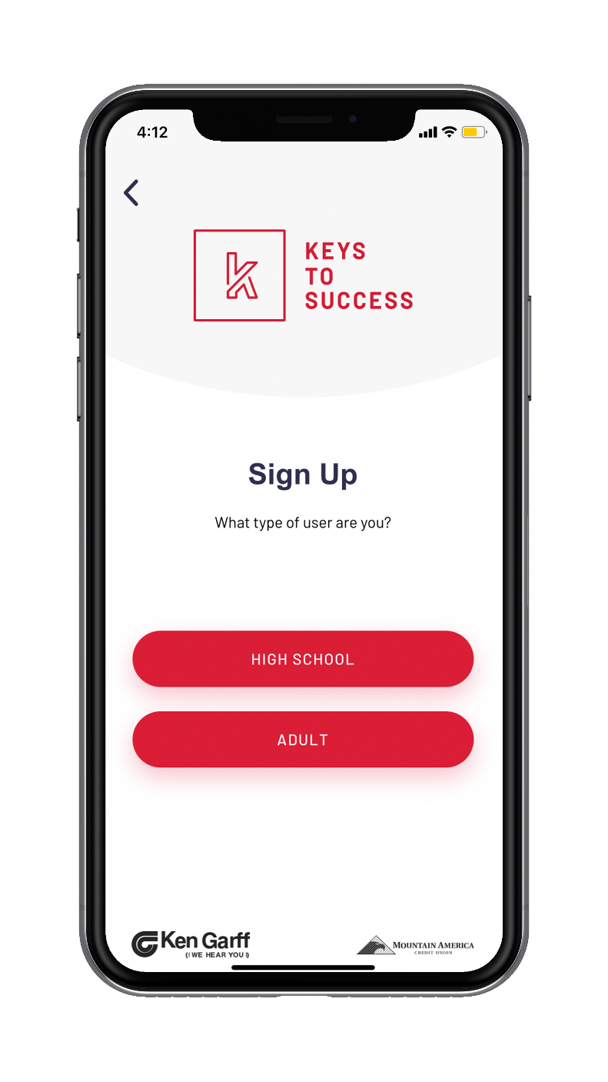
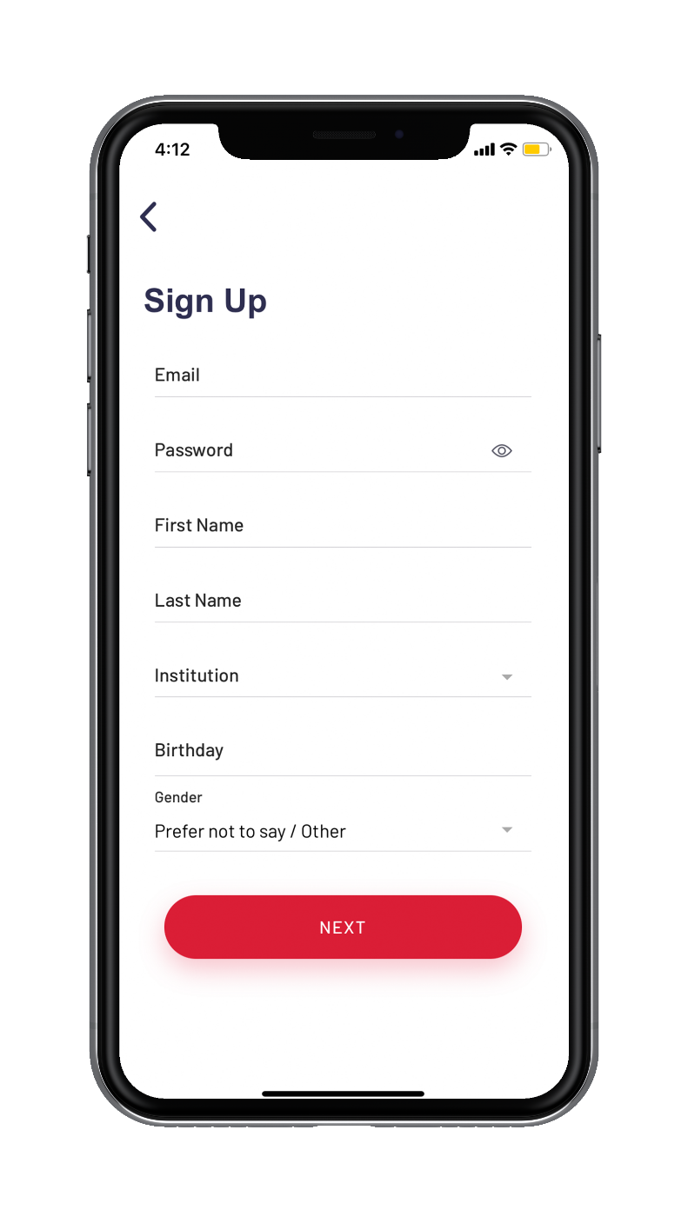
HOW IT WORKS
Download the Keys to Success Utah app! Full desktop version available at:
WWW.KTSUTAH.ORG/ENDEAVOR
You will create an account and fill out your information!
For “Institution” you can select the school you are attending, if you aren’t in school you can choose “No School”.
Notes:
Type in "Keys to Success Utah" in the app store or go to our website listed here. If the adult user is currently attending an institution they can connect when they sign up. This way they can get notifications specifically from their school.

Slide 19
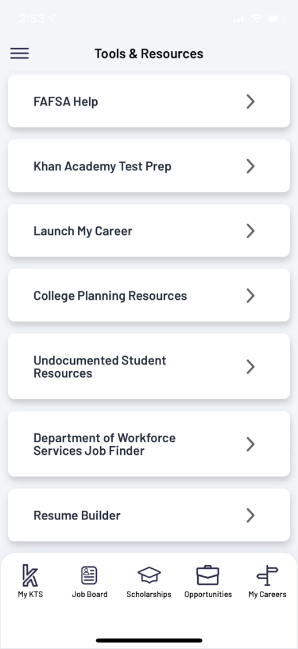
TOOLS & RESOURCES
Users have access to Tools & Resources in the Keys to Success app and website!
FAFSA Help
Khan Academy Test Prep
Launch My Career
College Planning Resources
Undocumented Student Resources
DWS Job Finder
Resume Builder
JustServe
More resources are available at our website www.ktsutah.org!
Notes:
Lastly, I will note that there are multiple resources under "Tools & Resources" that are really helpful for undocumented students or college and career planning, like a resume builder.

Slide 20
QUESTIONS?
WWW.KTSUTAH.ORG

Slide 21
THANK YOU!
Emma Checketts
Program Manager of Higher Ed
C: 801-9063754
emmac@sieutah.org
Mallory Santa Cruz
Program Director
C: 435-7400103
mallorys@sieutah.org
WWW.KTSUTAH.ORG

